Slide 1
DELEGATE QUESTIONNAIRES
FEEDBACK

Slide 2
Why

Slide 3
What

Slide 4
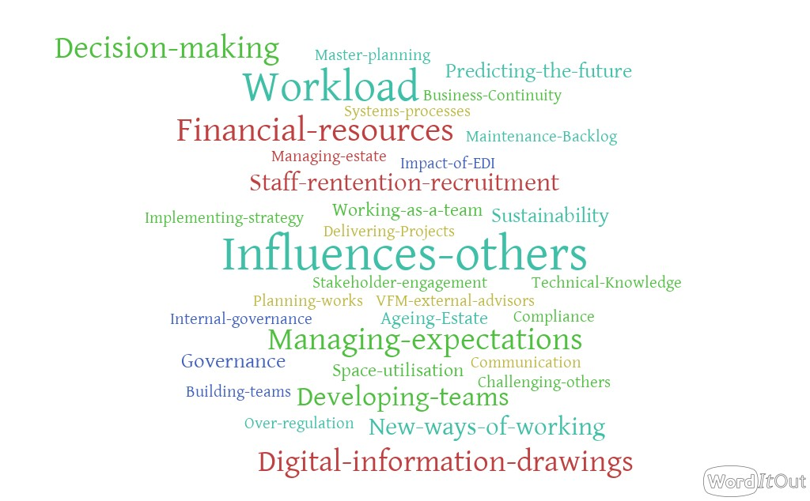
Challenges

Slide 5
Project Groups AUDE Summer School 2023
Group 1
Tom Ansell
Victoria Blake
Gaynor Bradshaw-Wilson
Kieran Brassil
John Brennan
Sandra Marcantuono
Graeme Wallace
Group 2
James Brewitt
Helen Buck
Dara Curley
James Davies
Tony Douglass
Laura Osborne- Fardon
Iain Hamilton
Group 3
Tony Dow
Claire Ferguson
John Goodwin
Matt Griffin
Phil Beardmore
Drew Hardie
Rebecca Horley
Sisa Mbeki
Group 4
Majid Khan
Kinga Konopka
Matt Lee
Emma Lovegrove
Jennifer Makkreel
David Manfield
Jim Bowditch
Group 5
Andrew Mouat
Richard Storrow
Heather Munro
Annie Rigg
Chris Rockall
Ian Rooney
Albina Saidova
Martyn Coote
Group 6
Debbie Smith
Gordon Mcleod
Nare Tshimangadzo
Steven Twynholm
Tom Vasey
Philip Dalgleish
Agnieszka Wigiel
Chris Willis
Notes:
Don’t get too excited we are not on strictly!!

Slide 6
The Project Criteria
Why (10%)– Has the group defined its project focus clearly. Have they understood the scope and set out a clear plan of action. Has the group understood the opportunity for taking a quantum leap in thinking on the chosen topic.
What (50%) – The quality of the submission, has a compelling case been made for the actions to be taken on the chosen project, is it underpinned by comprehensive research and engagement with a wide range of stakeholders.
How (20%)– Looking at the approach the groups have taken, the engagement with stakeholders, how they have worked together and collaborated as a group (enthusiasm, passion and initiative), signs of innovations adopted.
So What (20%) – Will the recommendations been made by the group make a real difference at institutional and or sector level.

Slide 7
Timelines and Deadlines
Brief overview of your groups approach and scope of your project (10 minutes max) to be delivered this Thursday 11.45 to 13.15
Friday 29 September 2023 - Summary of your Group’s Summer School highlights; what were your main insights and key takeaways (c.1200 words)
Friday 17 November 2023 -Final report including outline of your Group Project; scope, impact, learning and further recommendations (c.3000 words plus final presentation at Reconnect)
Thursday 30 November 2022 - Cohort Reconnect and Group Presentations
The Group considered to have best met the full brief will be invited to present their findings at the 2024 AUDE Annual Conference

Slide 8
Never Stop Learning Because Life Never Stops Teaching

Slide 9
How you can fulfil your potential
FIXED MINDSET | Carol Dweck | GROWTH MIND
Fixed Something you are born with | SKILLS | Come from hard work Can always improve
Something to avoid Could reveal lack of skill Tend to give up easily | CHALLENGES | Should be embraced An opportunity to grow More persistent
Unnecessary Something you do when you are not good enough | EFFORT | Essential A path to mastery
Get defensive Take it personally | FEEDBACK | Useful Something to learn from Identify areas for improvement
Blame others Get discouraged | SETBACKS | Use as a wakeup call to try harder next time

Slide 10
Personal Action Learning Log
Area of learning | What action will I take | Priority (High, Medium, Low) | What Evidence will I have to show completion
Maintain my group network | Take an active part in the project group work | High | My personal contribution to the report. Participation in the Reconnect Event in November

