Slide 1
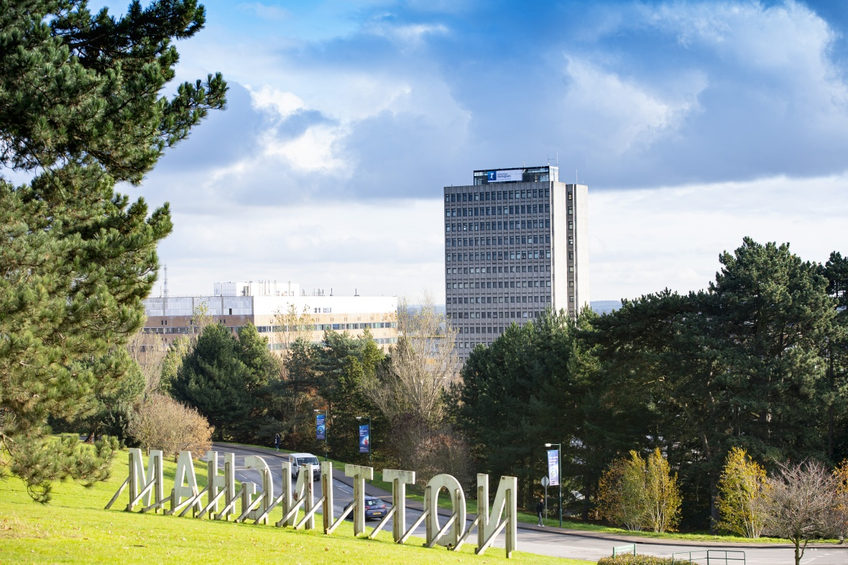
Notes:
Andy Nolan
This is an update – we are not asking for a decision – this is a briefing on the project to help ensure all of UEB are in a common place with regard to the project.
We’ve developed a proposal for a circa £28m investment
Also – this is not just a BUILDING Project – it’s a fundamental change project and a potential enabler of agile.
Current status :
4 enabling projects have been undertaken
Business case for Project Pinnacle as a PS Hub is in development
Approval from EIC to invest in planning and procurement
This is not a ‘done deal’ – but it’s hard to hide a key catalyst project with significant dependencies.

Slide 2
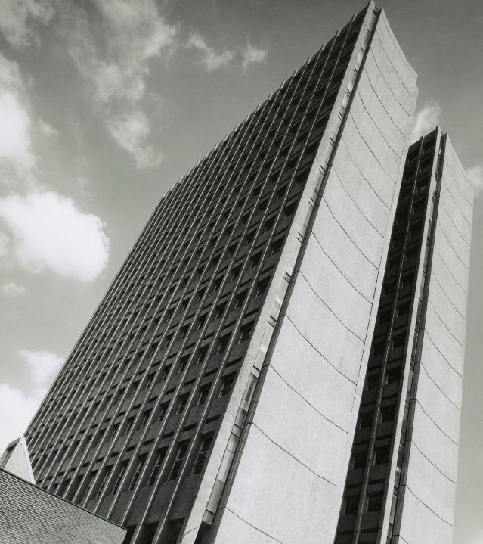
What is our opportunity?
Configuration of Tower limits uses
No longer fit for purpose for teaching use
Presents 5000m2 floor area
Presents an opportunity to be repurposed for a modern high utilisation, high sustainability development
Redeveloping the tower will:
Avoid releasing carbon sequestered during the original build
Create amenity for students and staff
Provide a space that supports agile working patterns as part of a network of hubs across our Campuses
Notes:
Andy Nolan
Pre-Covid Assigned Office and Meeting Space m²:
KMC = 6,294
Pope = 1052 (inc libraries and careers – so basically all of the quad)
JCC = 832
Estates Office = 458
Total = 8636
Future Assigned Work Space m2:
Project Pinnacle = 4056 (this is workspace in the tower, overall NIA as James says is 6264))
Yang Fujia = 1956
Total = 6015
targeting at least a 25% reduction in PS footprint as part of the occupancy model

Slide 3
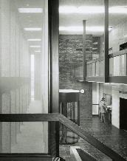
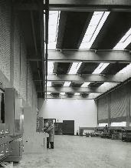
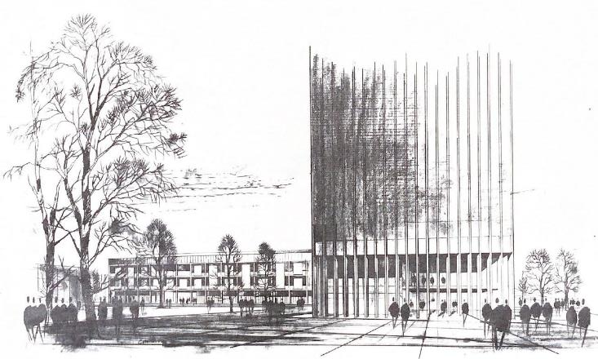
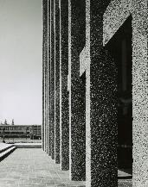
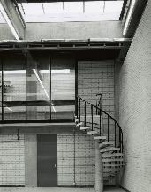
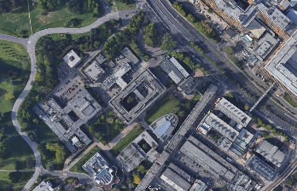
Project Pinnacle
History
15 storey Brutalist concrete tower with 2 storey workshops attached
Completed in 1965
Designed by Sir Basil Spence
Original concept sketch showing the tower and Chemistry building
Notes:
Richard Wigginton

Slide 4
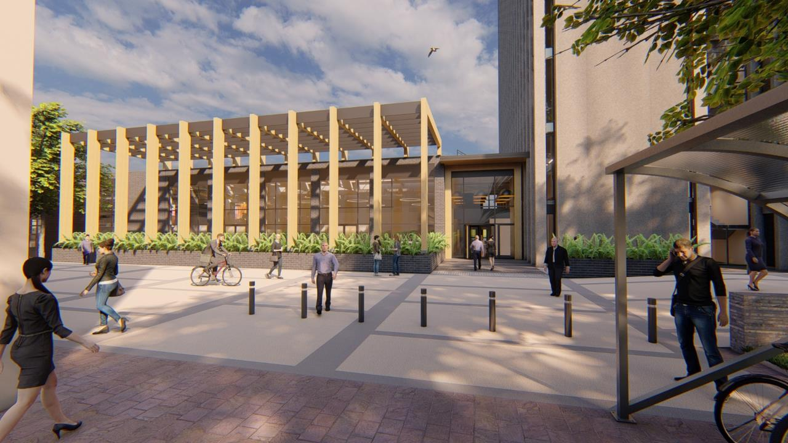
Project Pinnacle
Improved Main Entrance
Notes:
Andy Nolan

Slide 5
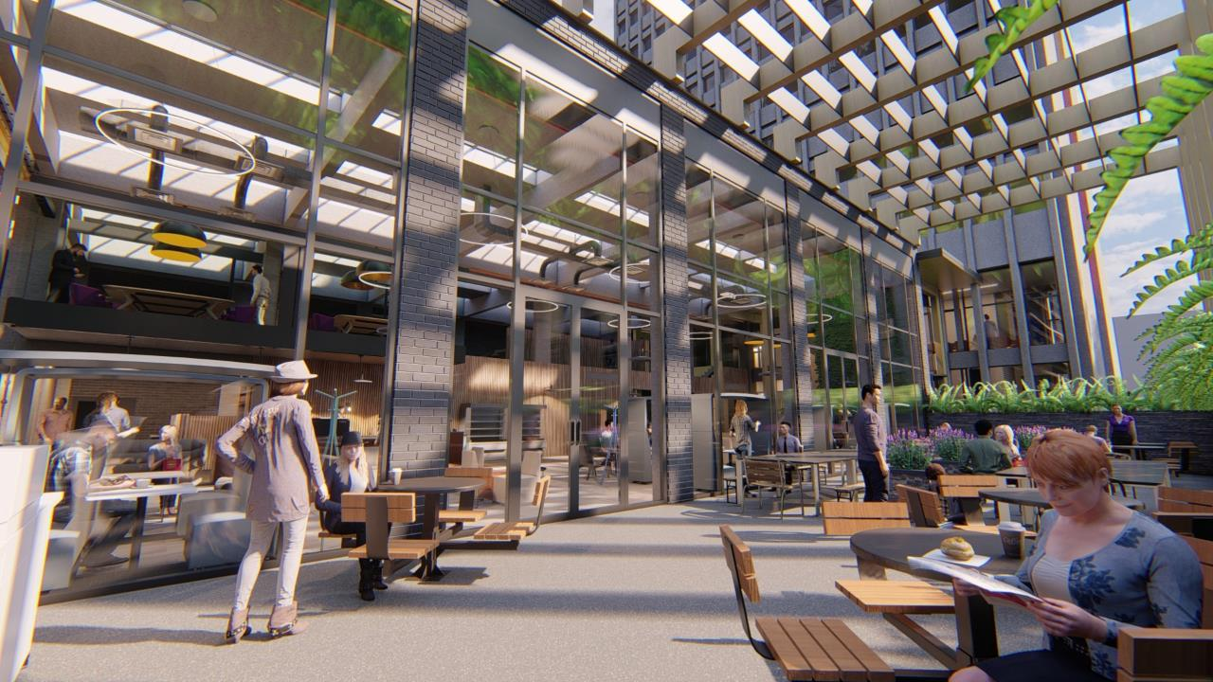
Project Pinnacle
New External Terrace

Slide 6
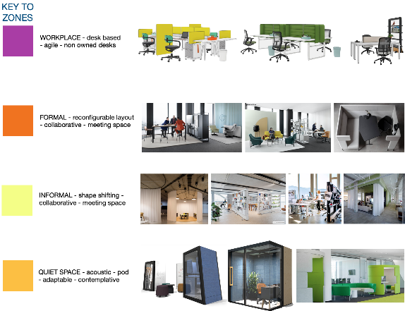
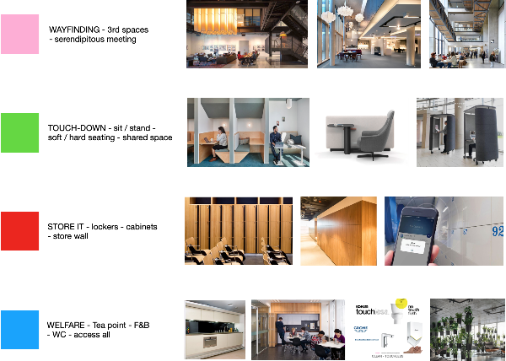
Project Pinnacle
The space design is about enabling future working patterns
Activity based design will avoid siloed territorialisation of spaces, promoting higher utilisation
There will also be parallel policy and tech developments
Activity Based Design
Notes:
Alex Wright

Slide 7
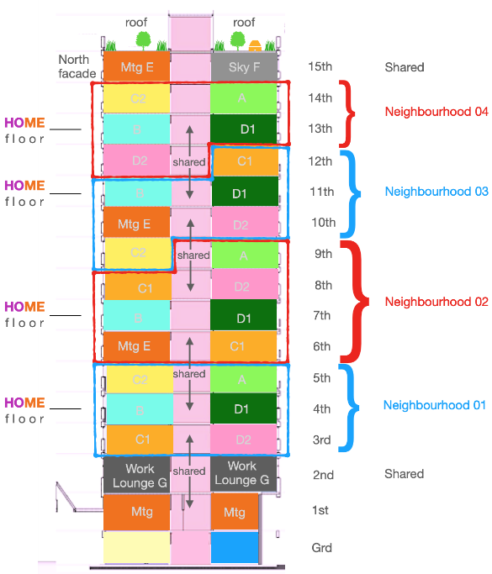
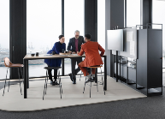
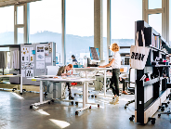
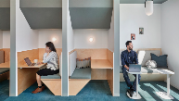
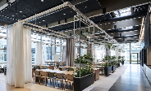
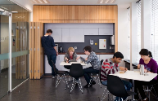
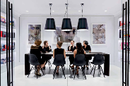
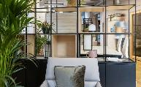
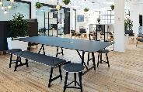
Project Pinnacle
Vertical Neighbourhoods
Notes:
Alex Wright

Slide 8
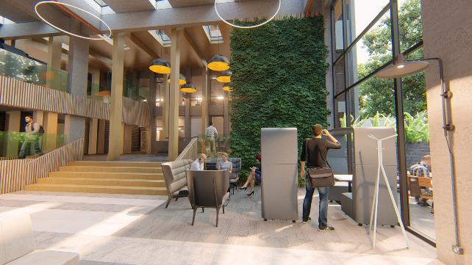
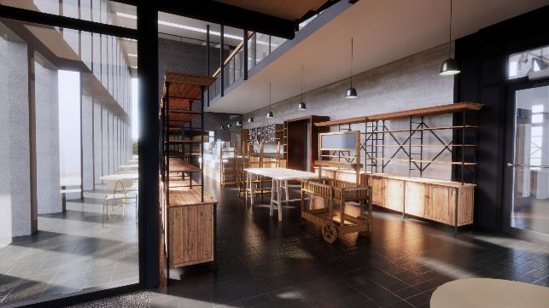
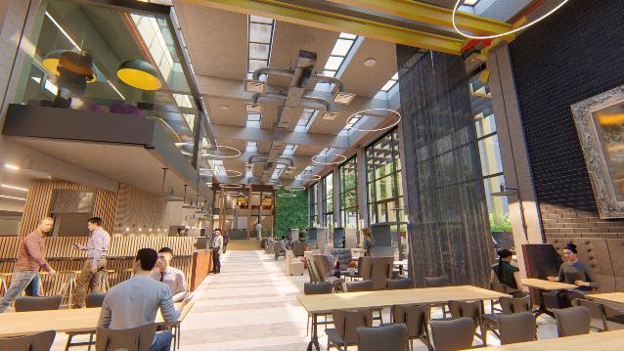
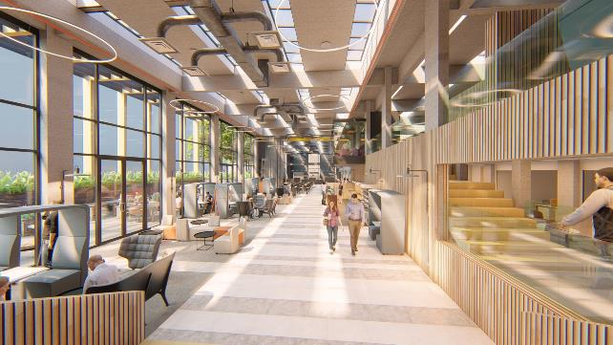
Project Pinnacle
Flexible, All Day Spaces
Notes:
Andy Nolan

Slide 9
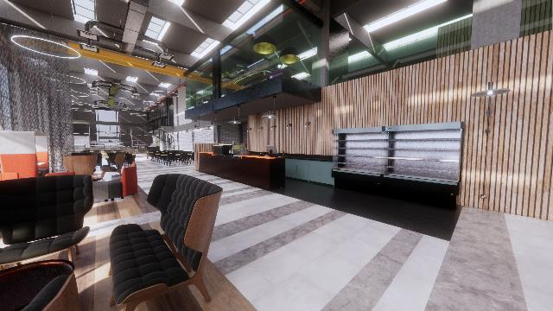
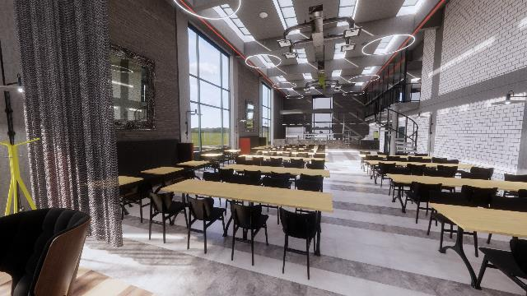
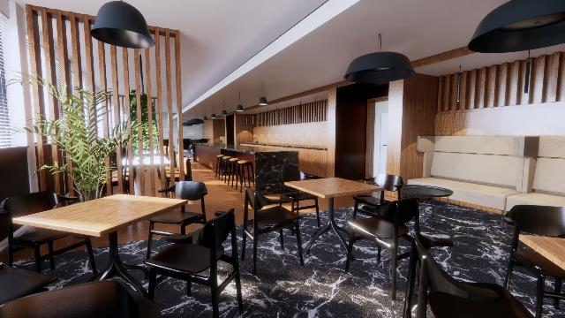
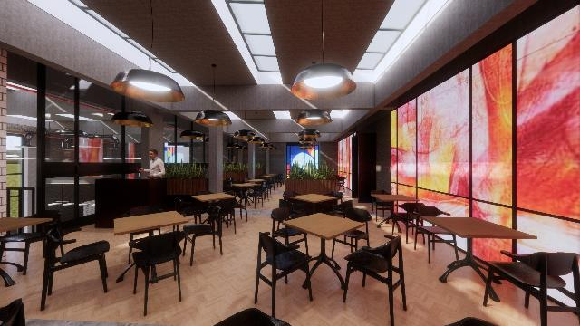
Project Pinnacle
Work / Meet / Relax

