Slide 1
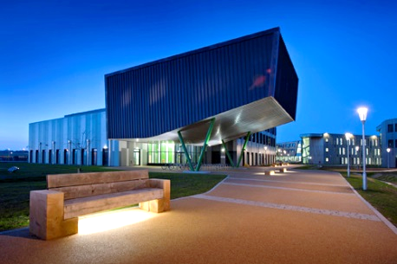
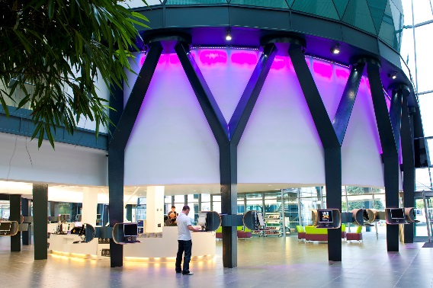
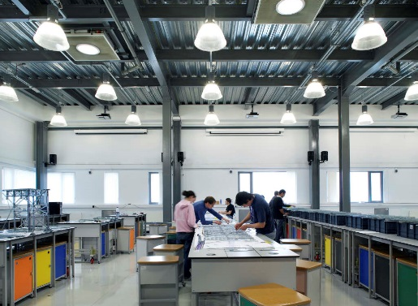
Sustainability Leadership Scorecard
Andy Sheppard
Arup

Slide 2
Overview
Scoring
Scope 3
Broader:
What?
Why?
SLS Structure
Web Portal
Case Studies
Summary
Questions
Mapping
GSC
Outputs
Gap Analysis
Notes:
SLOW!
Reminder on released version is brief – changed since last conference.

Slide 3
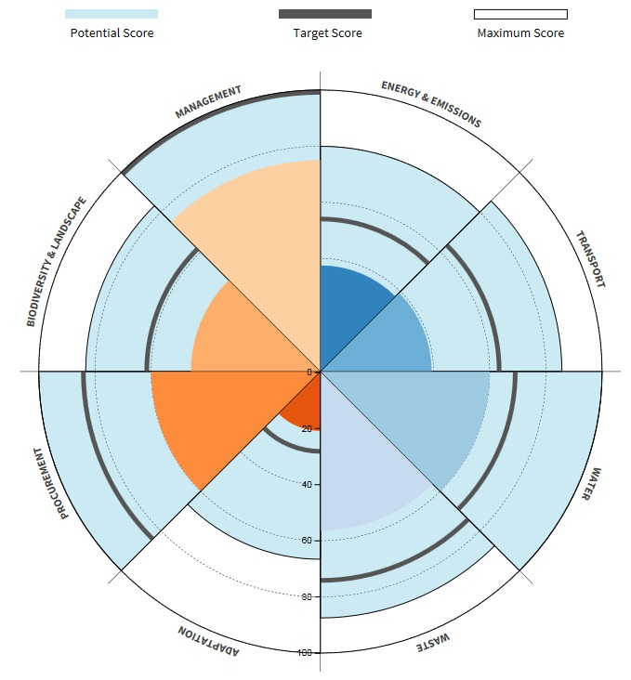
Green Scorecard
Background
Launched 2016, updated 2017
High take-up
Responded to sector needs:
1
2
3
Provide a framework for progress
Drive innovation within the sector
Motivate the wider university community
Non-competitive
Collaborative
Communicative
Notes:
100 unis in 1st 3 months, 88 in the last year
We’ve kept these qualities going forwards

Slide 4
The need for a wider context
Sustainability in HE
e.g.
Curriculum Community
Estates & FM
(indirect)
Estates & FM
(direct)
e.g.
e.g.
Energy Water
Travel Procurement
Notes:
Direct and indirect in GSC
Recognise that the scope of influence is variable
No longer hard lines between Estates and others. Can be blurred if helps.

Slide 5
Why do it?
Leadership
Framework for progress
Aimed at communicating with Senior Leadership Team
Relates to wider issues:
Reputation
Student engagement & satisfaction
REF, TEF
Graduate attributes & outcomes
Internationalisation
Directors
Strategy and importance
Results, feedback and issues
Management
Practitioners
Notes:
Doesn’t happen in every university
Something I’ve been battling with in Arup

Slide 6
Priority Areas → Framework Areas → Activity Areas
Leadership & Governance
Partnership & Engagement
Learning, Teaching & Research
Estates & Operations
Notes:
Structure
Will describe in a minute how GSC relates to this
Highlight E&O

Slide 7
Priority Areas → Framework Areas → Activity Areas
Leadership & Governance
Partnership & Engagement
Leadership
Staff Engagement & HR
Community & public engagement
Business & industry interface
Health & wellbeing
Risk
Procurement & supplier engagement
Food & drink
Learning, Teaching & Research
Estates & Operations
Learning & Teaching
Research
Waste
Biodiversity
Construction
Water
Travel
Adaptation
Student Engagement
Energy
Notes:
Some E&O titles truncated (e.g. Resource Efficiency & Waste)
ALL ARE OPTIONAL

Slide 8
Priority Areas → Framework Areas → Activity Areas
Leadership & Governance
Partnership & Engagement
Leadership
Staff Engagement & HR
Community & public engagement
Business & industry interface
Health & wellbeing
Risk
Procurement & supplier engagement
Food & drink
Learning, Teaching & Research
Estates & Operations
Learning & Teaching
Research
Waste
Biodiversity
Construction
Water
Travel
Adaptation
Student Engagement
Energy
Notes:
So you could do all within E&O + selected others
Or open it up wider

Slide 9
Priority Areas → Framework Areas → Activity Areas
Policy & strategy
Estates & Operations
Stakeholder engagement
Waste
Biodiversity
Construction
Water
Travel
Adaptation
Action planning
Energy
Measurement
Communication
Training & support
Score 0-4 based on descriptions
Similar to Green Scorecard
Implementation & performance
Link to curriculum
Notes:
Some E&O titles truncated (e.g. Resource Efficiency & Waste)
Not specifically linear process but can see some logic to the order.

Slide 10
Scoring
Background
Simple percentage achieved
No weighting
Empty answers counted as zeros
At overall & Priority Area level
Visible only to you
Notes:
Can imagine what average score you need to achieve in each activity.
So a middle rating in each will get you a bronze.

Slide 11
Tool mapping – Green Scorecard
 |  | Frameworks
 |  | Resource Efficiency & Waste | Biodiversity | Sustainable Construction, Renovation | Water | Travel & Transport | Climate Change Adaptation | Energy
Activities | Policy and Strategy |  |  | Ws7, M1, M2 |  | T2 | A6 | E10
 | Stakeholder Engagement
 | Action Planning | Ws8 | B5 | M3 | Wt1 |  | A1, A2, A4 | E7
 | Measurement |  |  |  | Wt1 | T1 |  | E7
 | Communication |  |  |  |  |  |  | E9
 | Training and Support |  |  |  |  |  |  | E9
 | Implementation and performance | Ws1, Ws2, Ws3, Ws4, Ws5, Ws6 | B2, B3, B4, B6 |  | Wt1, Wt2, Wt3, Wt4, Wt5 | T3, T4, T5, T6, T7 | A3, A5, B1 | E1, E2, E3, E4, E5, E6, E7, E8
 | Link to the Curriculum
Notes:
Tools are mapped
Won’t remember the codes but shows where GSC has the most influence on scores.
Average score where more than one.
Recommended scores only
Changing SLS does not back-amend GSC

Slide 12
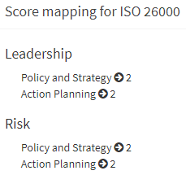
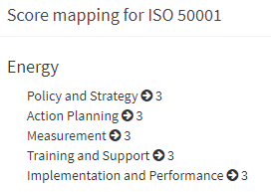
Tool mapping – others
 | Learning Teaching and Research |  |  | Leadership and Governance |  |  |  | Estates and Operation |  |  |  |  |  |  | Partnerships and Engagement
Policy and Strategy |  |  |  | 1 |  |  | 1 | 2 | 3 | 2 | 2 | 2 | 3 | 2 |  | 2 |  | 1
Stakeholder Engagement |  | 1 |  |  |  |  |  |  |  |  |  |  | 1
Action Planning |  | 1 | 1 | 1 | 1 |  | 1 |  | 1 |  |  |  | 1 |  | 1 | 1
Measurement |  | 1 | 1 |  | 1 |  |  | 2 | 3 | 2 | 2 | 2 | 3 | 2 |  | 2 |  | 1
Communication |  |  | 1 |  | 1 |  |  | 1 | 1 | 1 | 1 | 1 | 2 | 1 |  | 1
Training and Support |  |  |  |  | 1 |  |  |  | 1 |  |  |  | 1
Implementation, performance |  | 1 | 1 |  | 1 |  |  |  | 1 |  |  |  | 1 |  | 1 | 1 |  | 1
Link to the Curriculum |  |  | 2 | 1 | 1
NUS Green Impact
EcoCampus
Flexible Framework
NUS Responsible Futures
BREEAM
ISO14001
ISO50001
ISO26001
Food for Life
Notes:
Recommended scores only
Assumes a certain scope and level – info in narrative
Where more than one tool, maximum is taken
ISO26001 is social responsibility

Slide 13
Output mapping – UN SDGs
Seminal framework of the time
Frameworks aligned with 3 Goals
Potential impact – alignment of issues
Actual impact – alignment of effort
Notes:
Show of hands – who’s heard of them?
How are institution activities reflecting the goals
Primary, Secondary and Tertiary
Fully tailorable
In example, institution having medium impact but could have high impact.

Slide 14
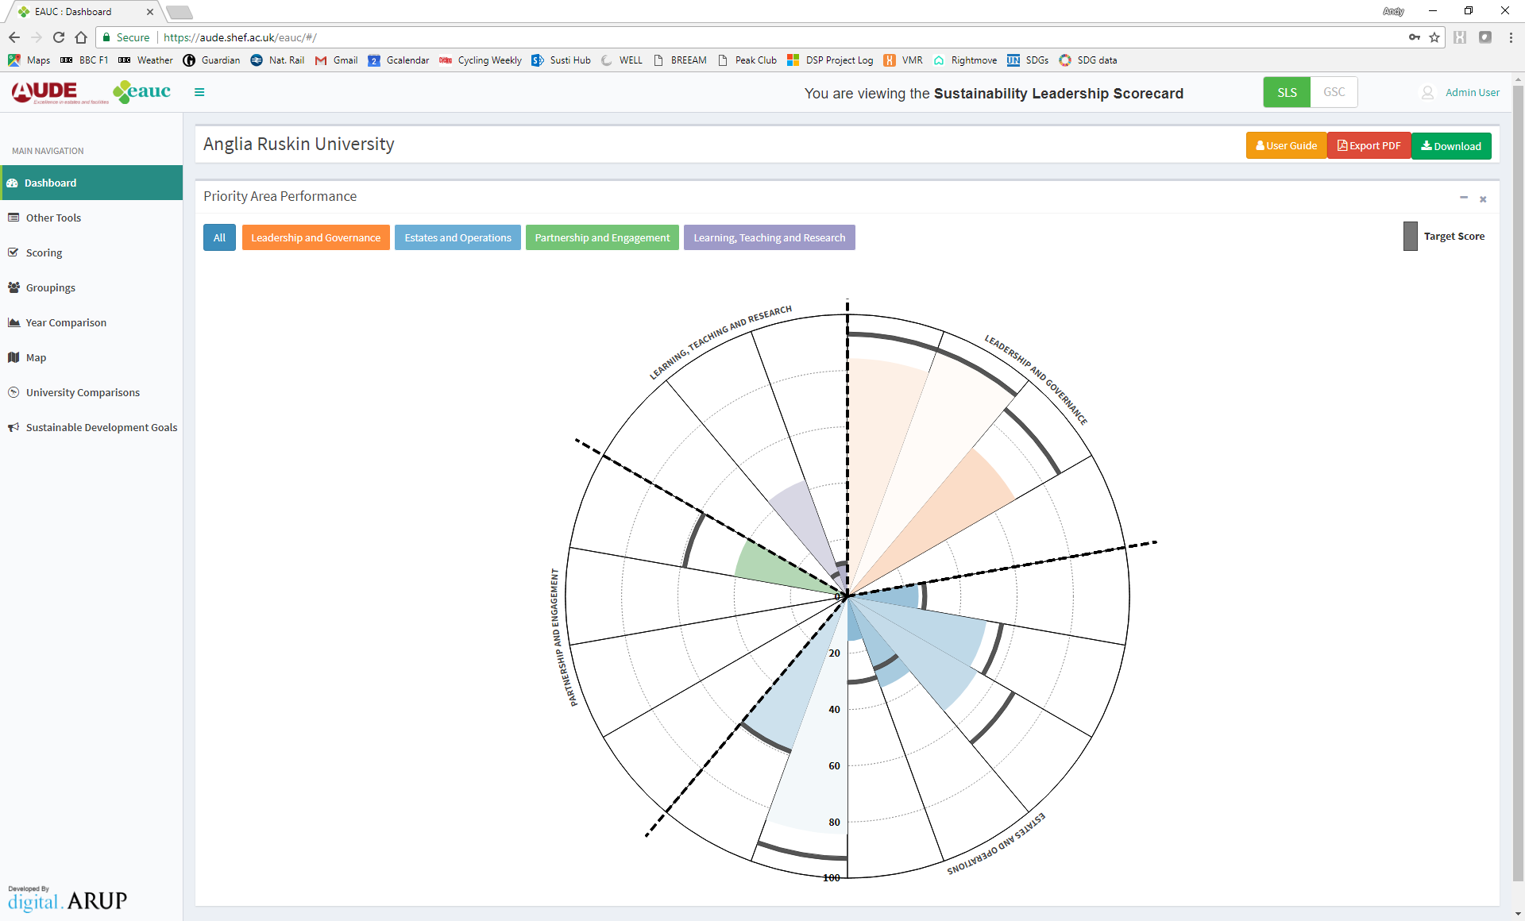
Website:
Dashboard

Slide 15
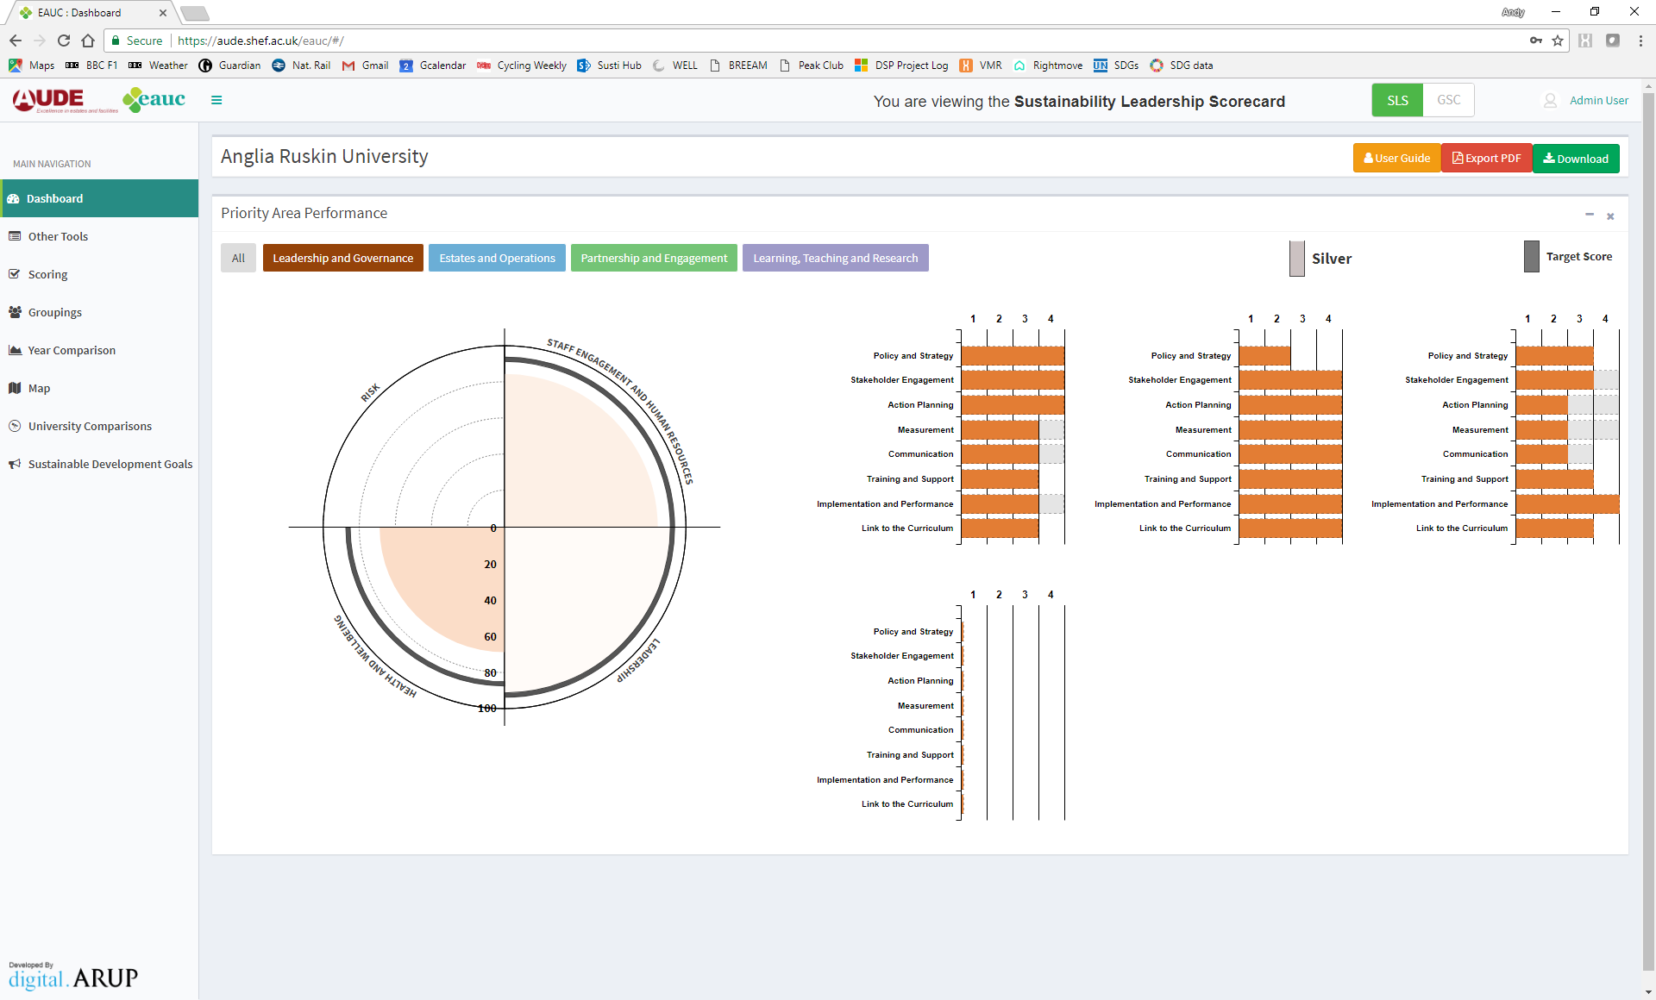
Website:
Dashboard

Slide 16
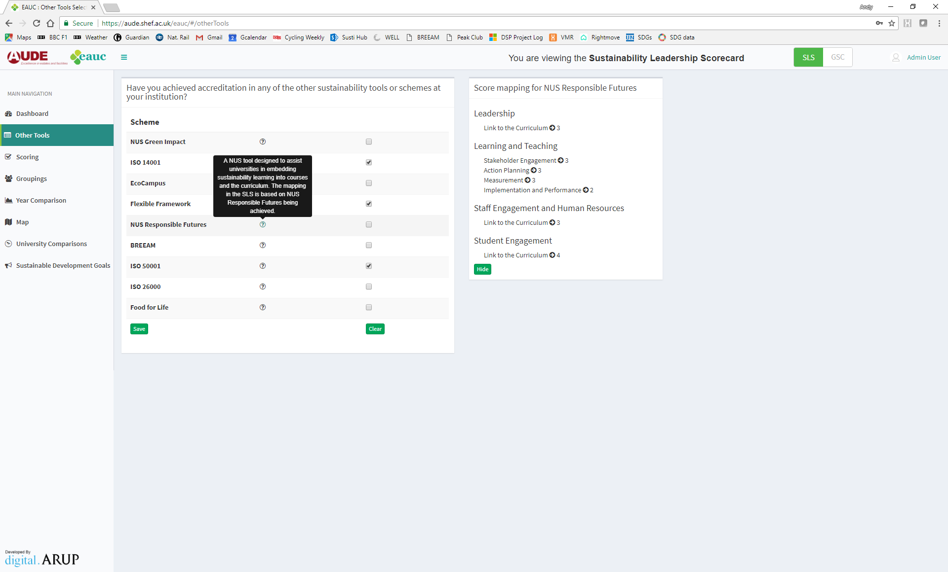
Website:
Tools

Slide 17
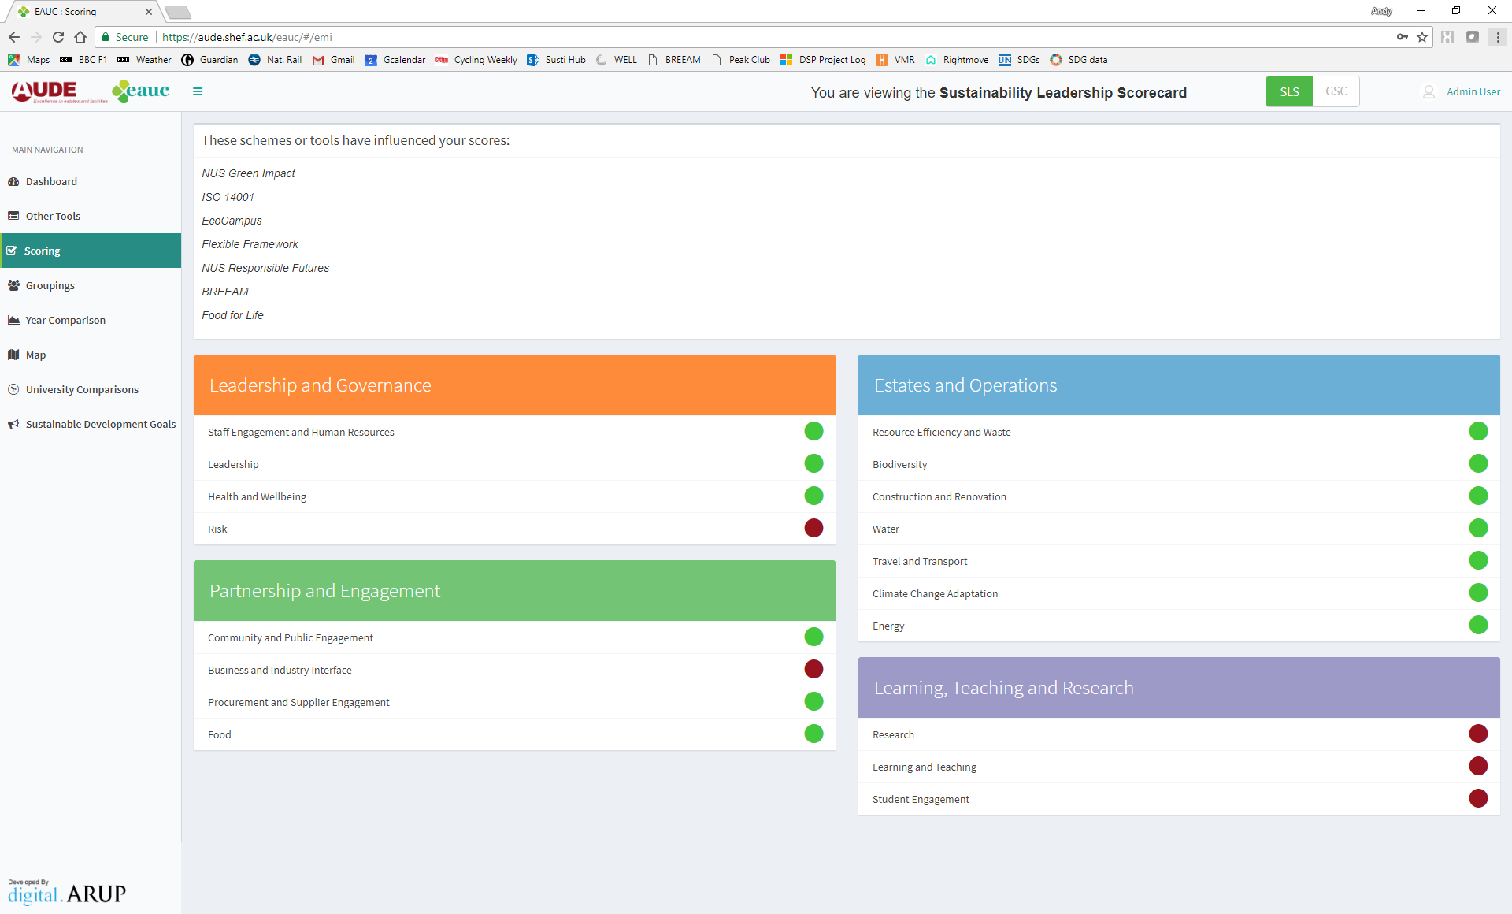
Website:
Scoring

Slide 18
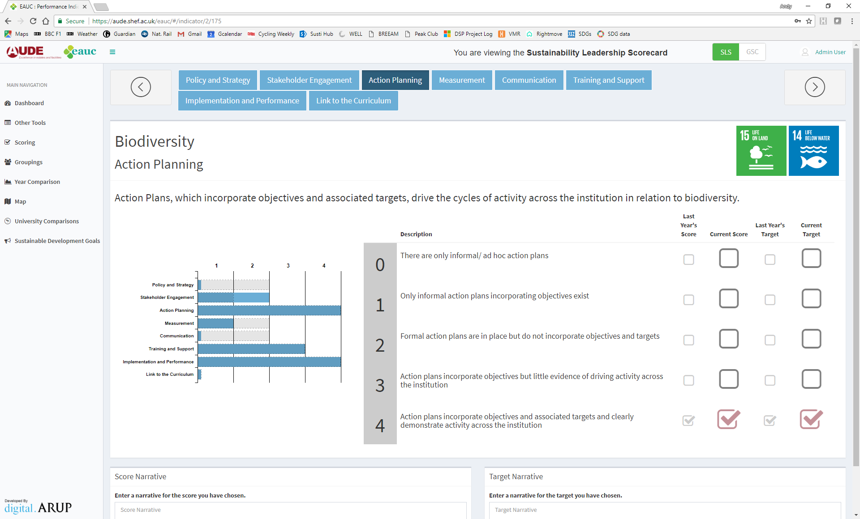
Website:
Scoring
Notes:
Main scoring input page
Eight Activity Areas under each Framework
Red indicates carried over from GSC. Can change and it will go green.
Orange indicates other tool impact.
Score narrative includes other tool impacts by default. Can be overwritten.

Slide 19
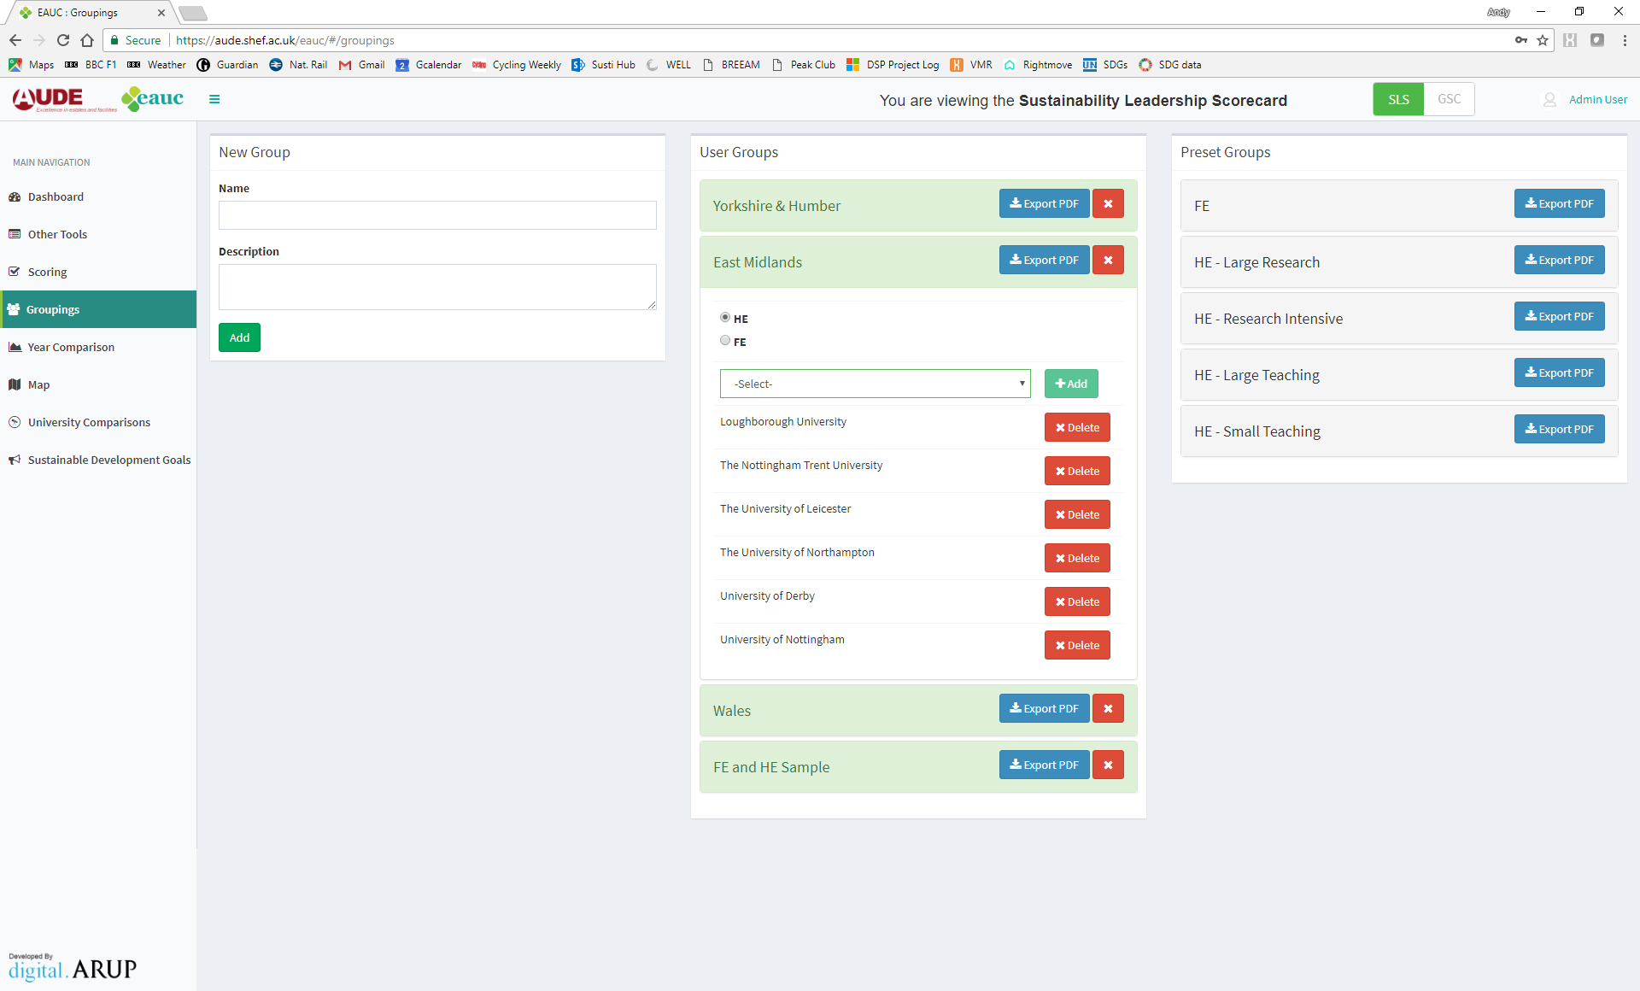
Website:
Groups

Slide 20
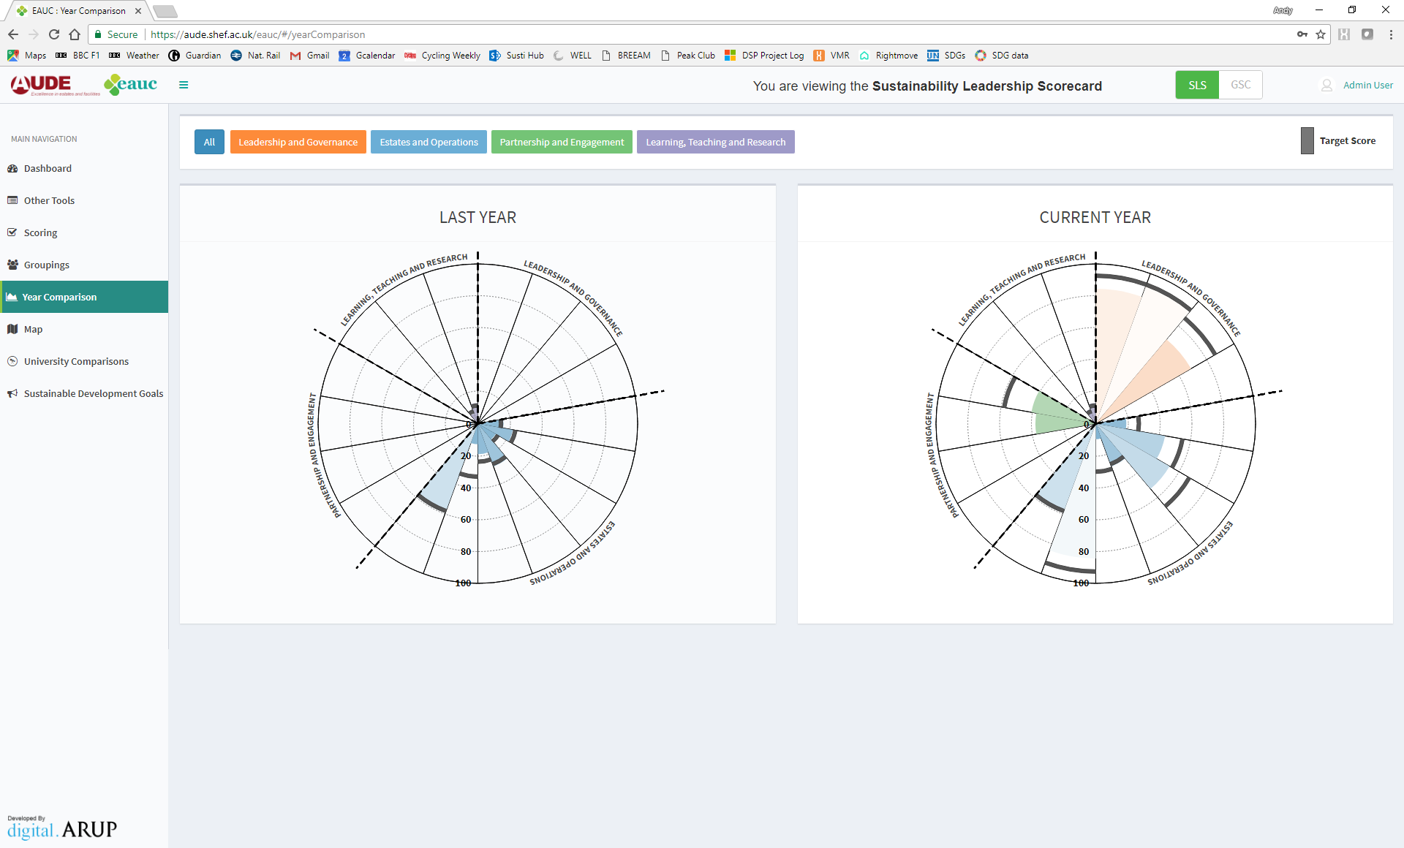
Website:
Progress

Slide 21
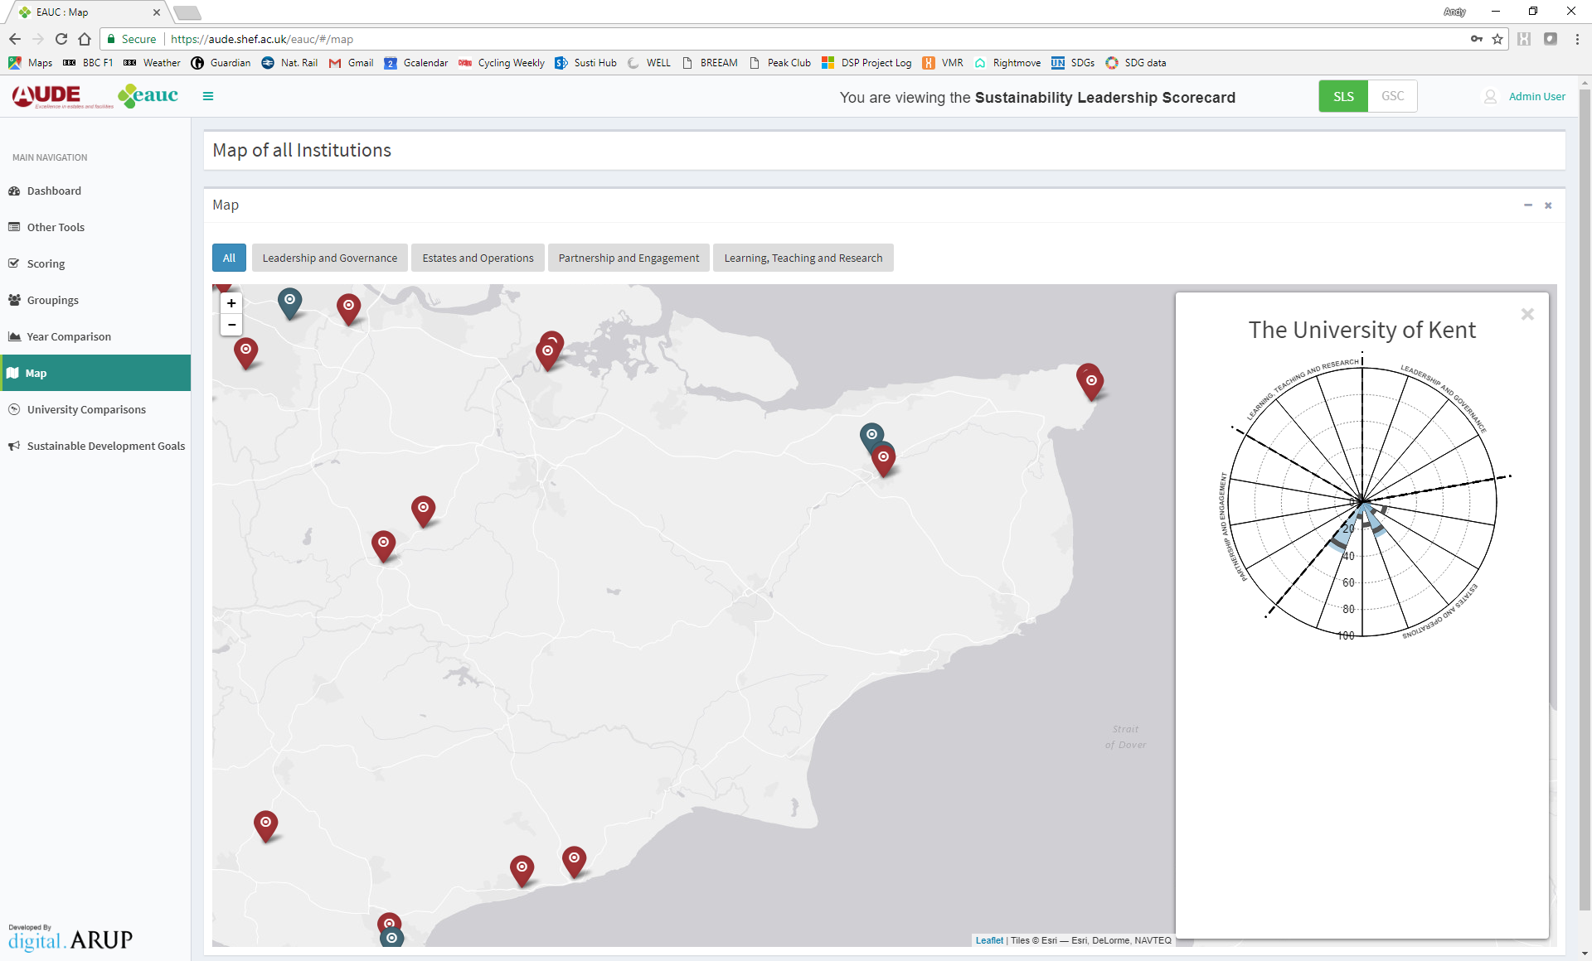
Website:
Map

Slide 22
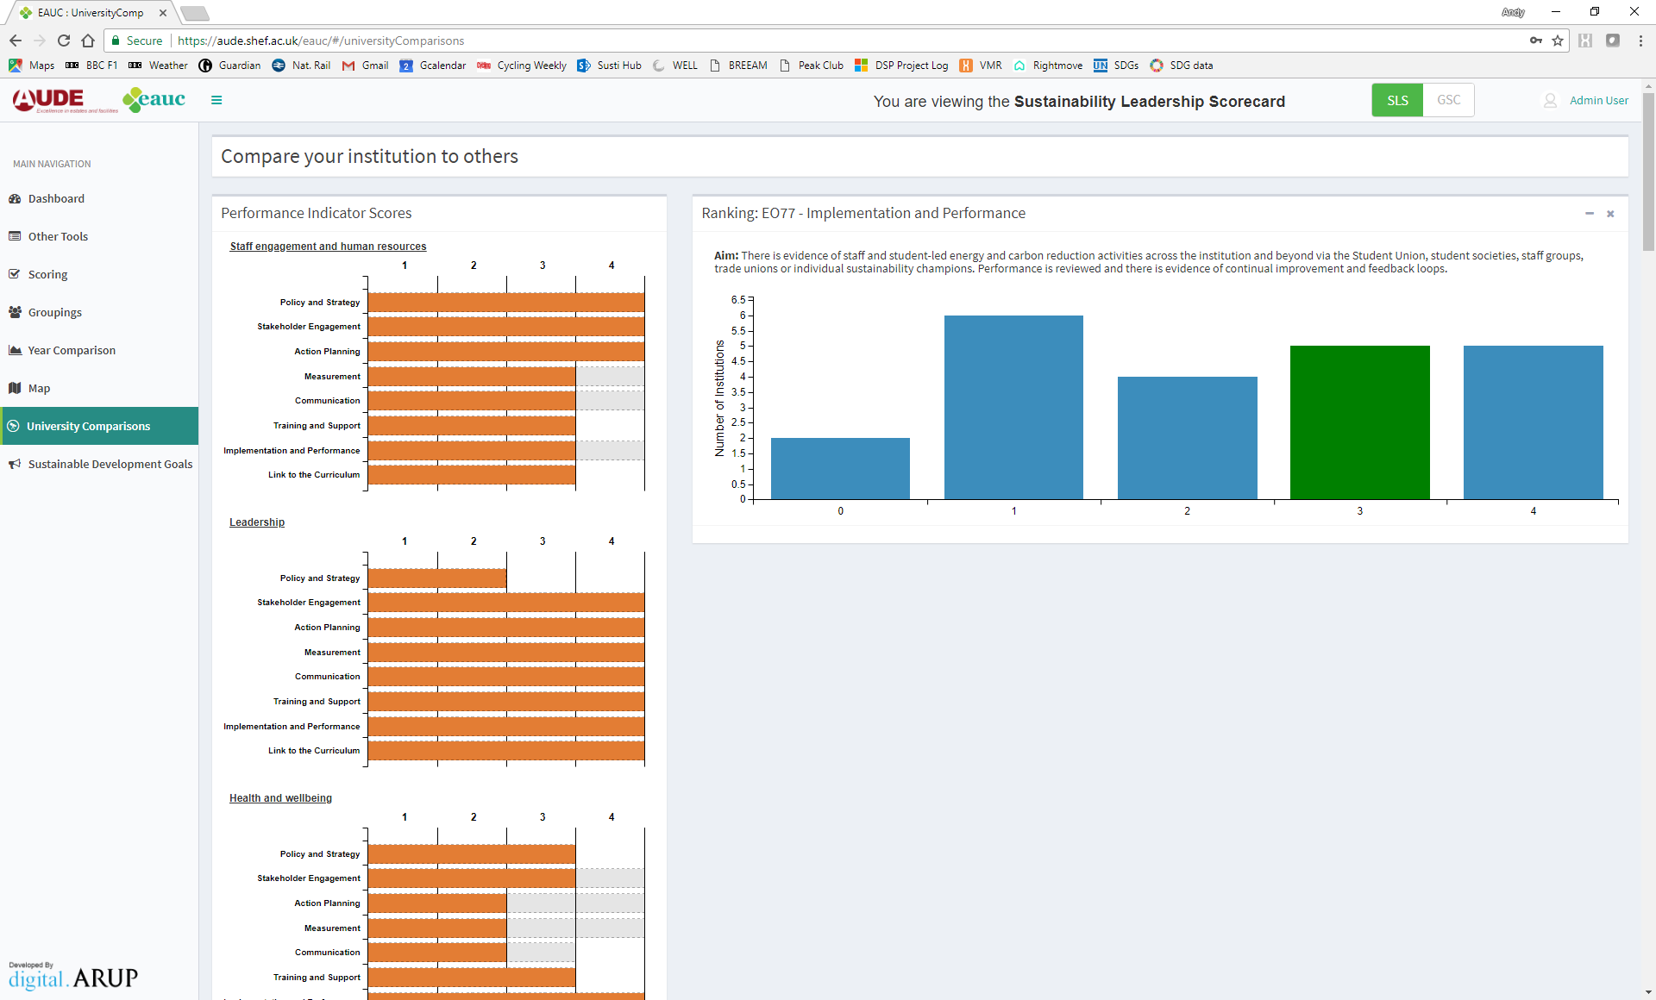
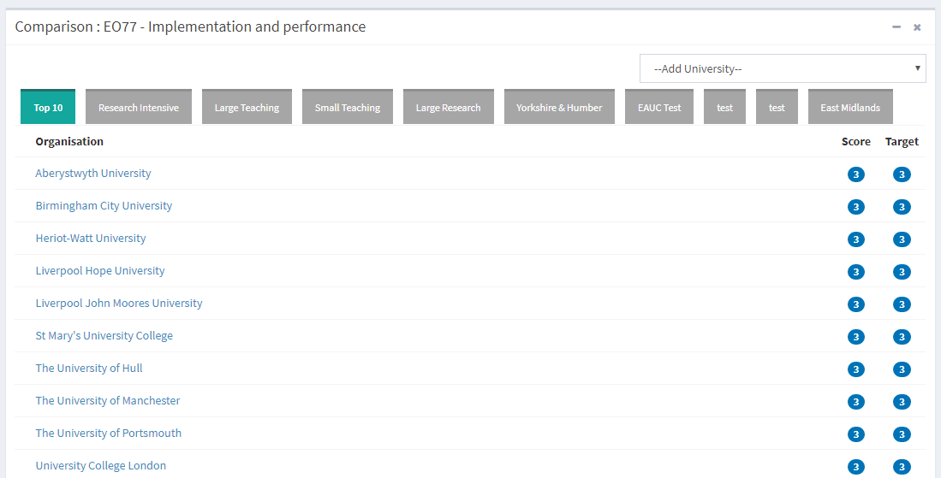
Website:
Compare
Notes:
Graphs look a little different to GSC EMR ones but they’re still available

Slide 23
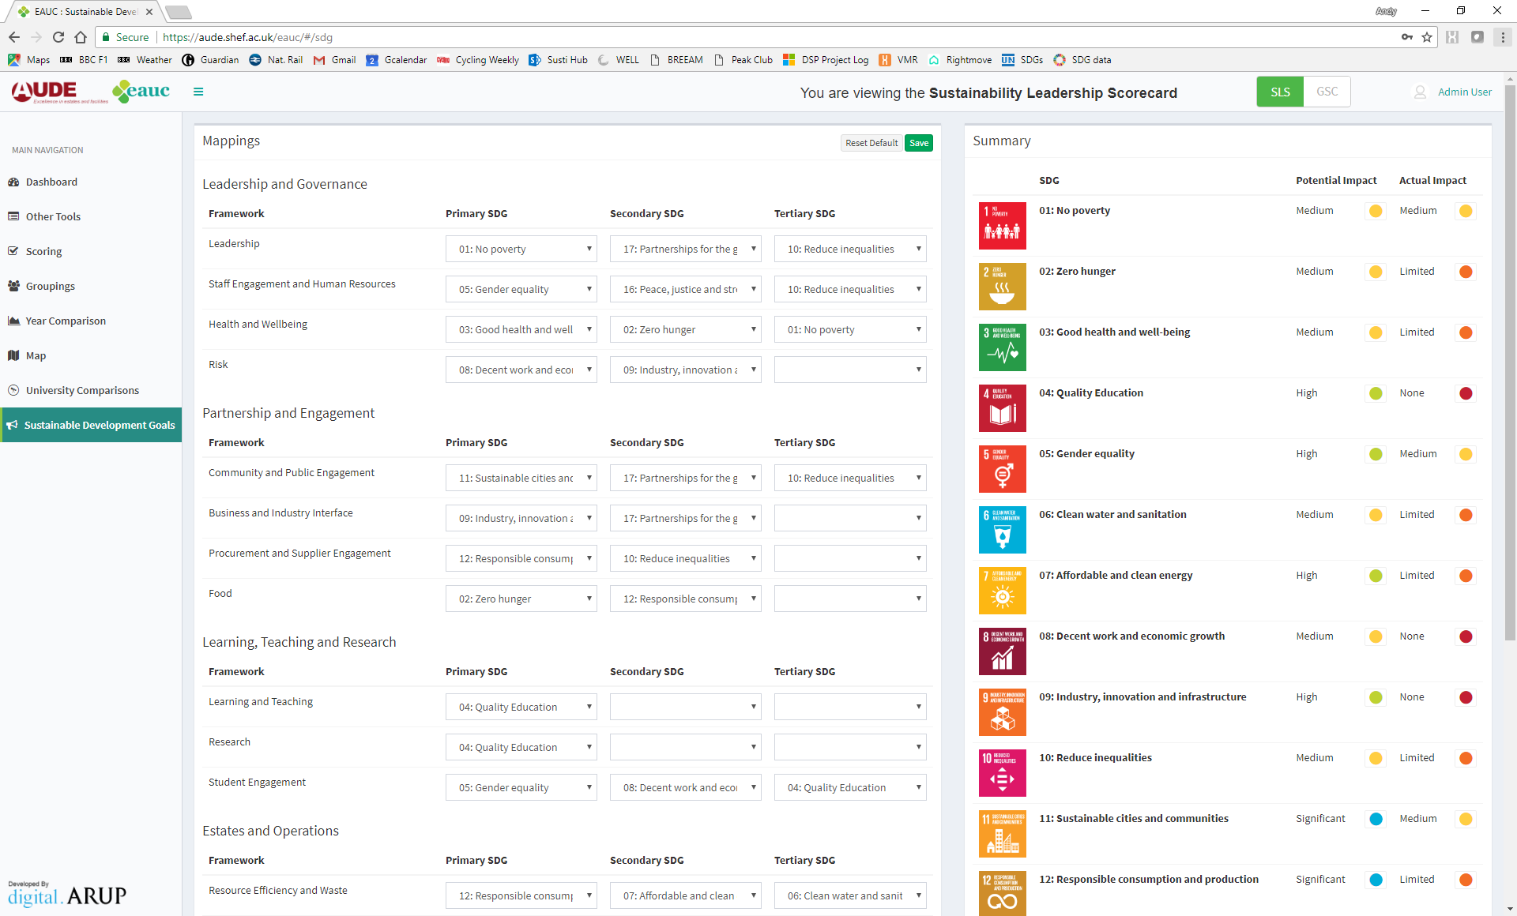
Website:
SDGs
Notes:
Remember you can see them in each page, too

Slide 24
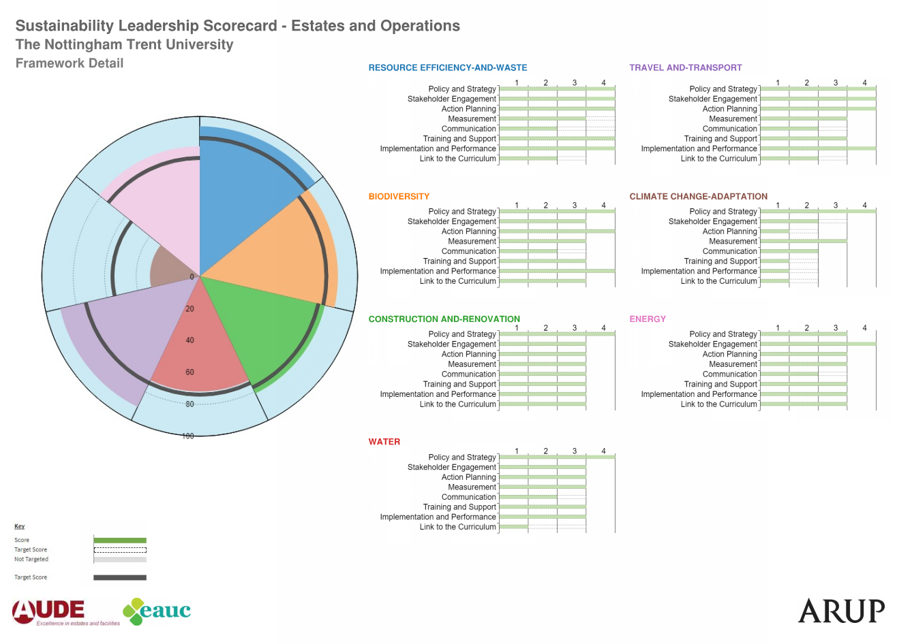
Report export
Notes:
Download and export pdf are difference

Slide 25
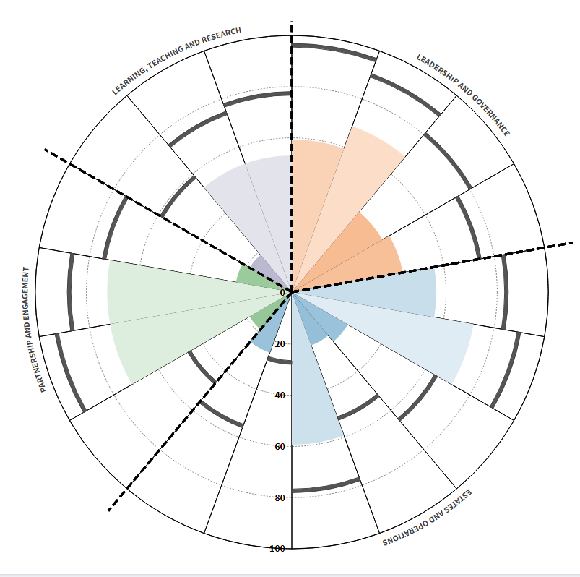
Case Study – Canterbury Christ Church University
Consistency across Priority Areas
Variability in frameworks
High aspirations
Notes:
Only guesstimates in some areas!
Good distribution across priority areas
Variation in framework
E,g. great on biodiversity, not on adaptation
Greatest stretch to target is Community & Public Engagement

Slide 26
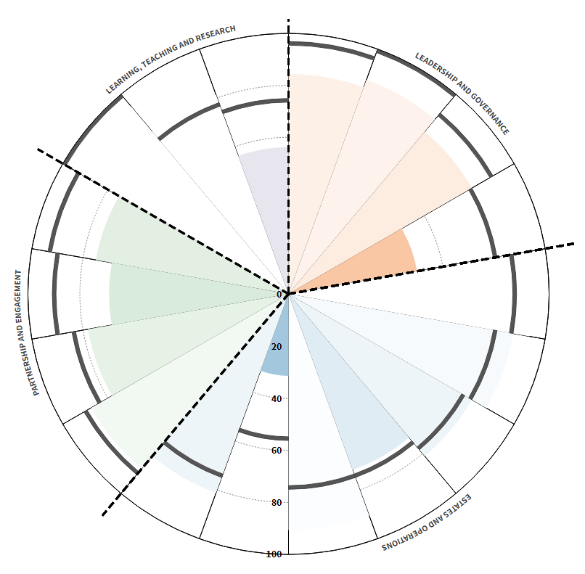
Case Study – Nottingham Trent University
Few areas of weakness
Exceeding target in some areas
Notes:
Some colours haven’t come out well
Measurement, training and Links are areas to focus on
Also climate change adaptation – not unusual
They want to generally get worse at policies!

Slide 27
Gap analysis
Self Assessment
3rd Party Review
Documents & Interviews
Consistency check
Recommendations
Verification
Outcome agreed
Purely optional
Institution to check progress
External progress map
Galvanises action
External communication
Notes:
Can imagine what average score you need to achieve in each activity.
So a middle rating in each will get you a bronze.

Slide 28
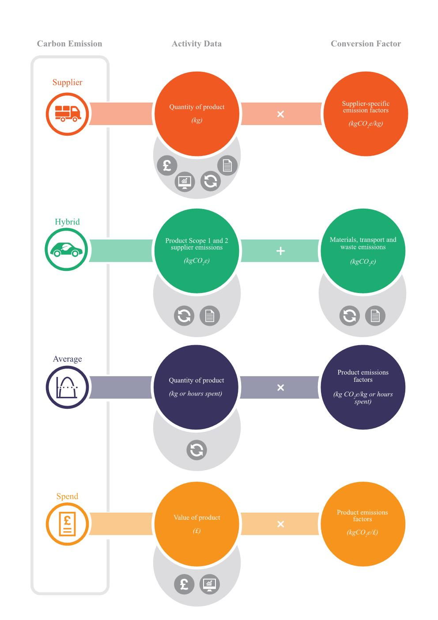
Scope 3
Slightly off-topic…
Most accurate
Guidance note created
Travel
Business travel
Procurement
Construction
Water
Staff & student commuting
ICT
Manufactured products
Business services
Food and catering
Water supply
Wastewater treatment
Waste
Re-use
Recycling
Composting
Combustion
Landfill
Least accurate
Notes:
Draws together, summarises and update previous guidance
Example is various routes for calculating procurement emissions

Slide 29
In summary
Structure of indicators in categories | ü
Non-competitive | ü
Collaborative | ü
Communicative | ü
No need for evidence | ü
Easy to use | ü
Flexible – no need to do everything | ü
Framework for progress | ü
Many characteristics of GSC continue
Optional broader scope
Optional gap analysis
Aimed at wider university issues
Launch early-mid May
Notes:
Draws together, summarises and update previous guidance
Example is various routes for calculating procurement emissions

Slide 30
Thank you – questions?
Andy Sheppard
andy.sheppard@arup.com
07825 198 132

